Slide 1

Loan Account Opening
Accounting Process

Slide 2
Key Points
Disbursement amount (New Money) – Amount that needs to be disbursed to customer.
External Consolidation amount – Sum of Other Banks Loan amount that customer wish to close.
Internal Consolidation amount – Sum of Internal Citibank accts Outstanding amount which customer wish to clear.
Total loan amount (Disbursement amount + External consolidation amount + Internal consolidation amount)

Slide 3
Loan Application Channels / GKVs
Possible Channels for Loan Applications:
I-Internet, L-Loan by Mail, P-Loan by Phone, M-MSF, B-Branch, C-Call Center, D-Collections
Channel level Loan GKVs can be maintained in system for Accounting Process.
This is a system maintained parameter and not user maintained.
If Channel Loan GKV is not found then system will consider Processing Branch Loan GKV.
Loan Clearing GL
(single for entire Germany)
Channel 1:
Mail-Loan GKV
Channel 2:
MSF-Loan GKV
Other Channels:
Processing Branch Loan GKV

Slide 4
Accounting Process
Step - 1 Total Loan amount will be moved from Loan Clearing GL to Channel/Processing Branch Loan GKV during loan booking.
Step - 2 External consolidation amount will be debited from Channel/Processing Branch Loan GKV and Credited to Account Domicile RC Loan Takeover GKV during loan booking.
Step - 3 Internal consolidation amount will be debited from Channel/Processing Branch Loan GKV and Credited to corresponding Loan account.
Step – 4 External consolidation amount will be debited from Account Domicile RC Loan Takeover GKV and Credited to External bank using a standing instruction. This is done in debt consolidation screen.
Step – 5 Disbursement amount should be debited from Channel/Processing Branch Loan GKV and Credited to Customer (Cash/Acct).
  Note –Steps 3,5 should be manually done by user.

Slide 5
Accounting Process Flowchart
Loan Clearing GL
Step -1:Transaction Amount = Disbursement Amount +
External Consolidation Amount +
Internal Consolidation Amount
A
Channel Loan GKV
Or
Processing Branch Loan GKV
Step 4: Disbursement
Amount
Step 3: Internal Consolidation
Amount
M
Step 2:External
Consolidation Amount
M
A
Transfer through Cash or to Customer’s DDA
Account Domicile RC
Loan Takeover GKV
Pay-off to the Loan Account
A
Step 5: To External Bank
M
- Manual Process
- Automatic Process
Payback to External Bank
A

Slide 6
Sample Flow
Loan Clearing GL - ZZZZZZZZZZ
Branch | Loan GKV | Loan Takeover GKV
Düsseldorf | AAAAAAAAAA | BBBBBBBBBB
Duisburg | XXXXXXXXXX | YYYYYYYYYY

Slide 7
Sample Flow
Customer goes to his domicile branch (Dusseldorf) to take out a loan.
Details as follows:
  Loan Amount: 10.000,00
  Disbursement Amount: 5.000,00
  External Debt Consolidation Amount: 3.500,00
  Internal Debt Consolidation Amount: 1.500,00
Cash/Customer Acct
5.000
Loan Clearing GL
ZZZZZZZZZZ
Dusseldorf
Loan GKV
AAAAAAAAAA
Dusseldorf
Loan Takeover GKV
BBBBBBBBBB
10.000
3.500
Pay-off Loan Account
00000000000339
1.500

Slide 8
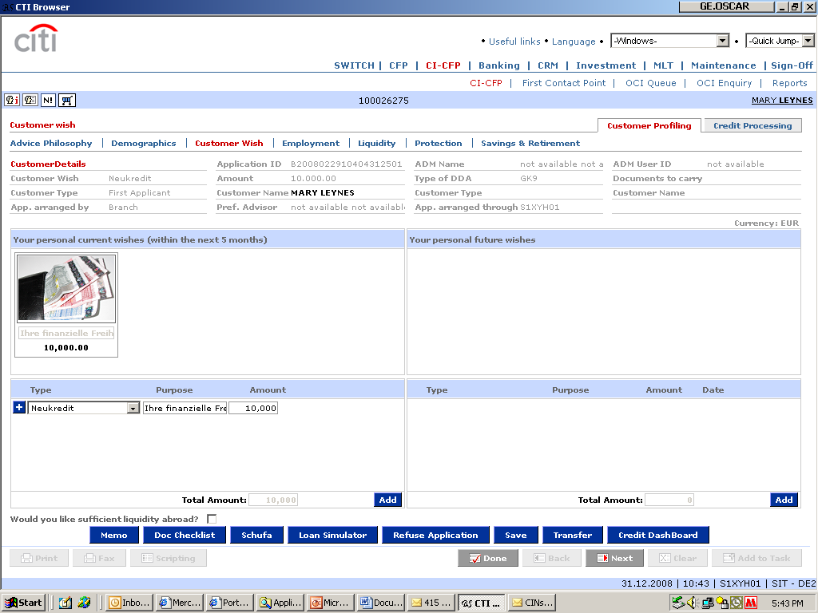
Consultation Flow
Customer Wish:
Personal Installment Loan EUR 10.000

Slide 9
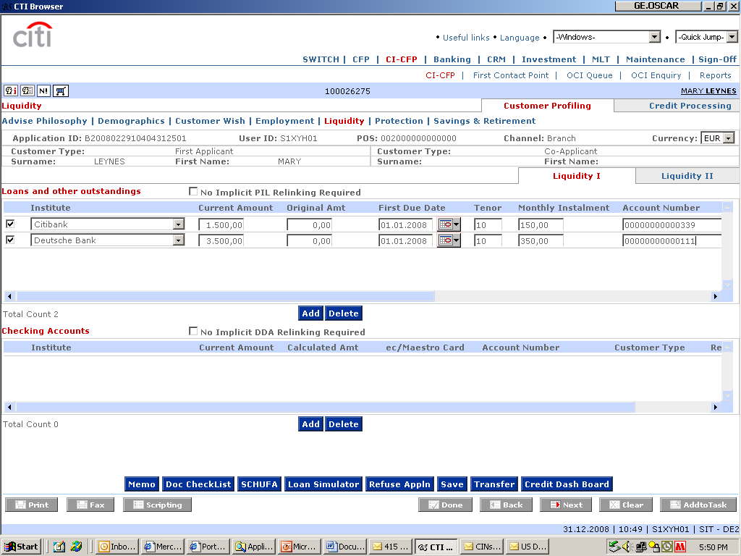
Consultation Flow
Existing Citibank Loan:
Acct No: 00000000000339
Amount: 1.500
Existing Deutsche Bank Loan:
Acct No: 00000000000111
Amount: 3.500

Slide 10
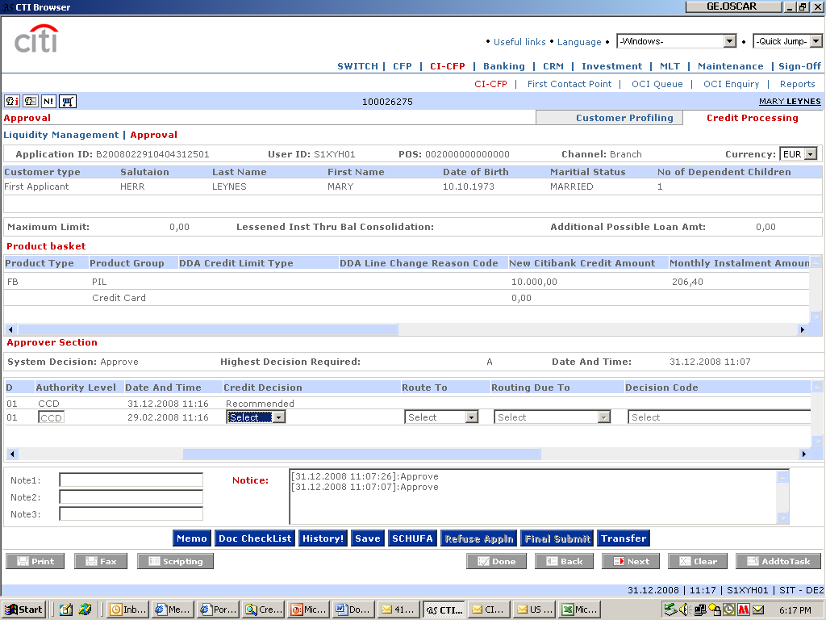
Product Trolley – Loan Account Booking
Application is Recommended and Approved

Slide 11
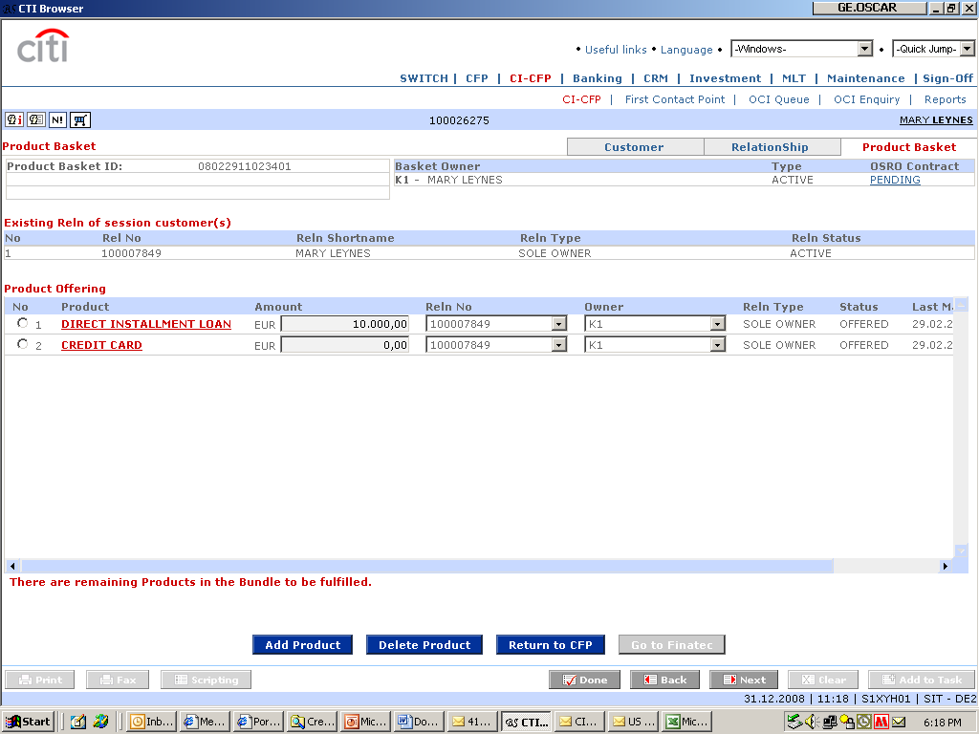
Product Trolley – Debt Consolidation
PIL is now Offered in the Basket

Slide 12
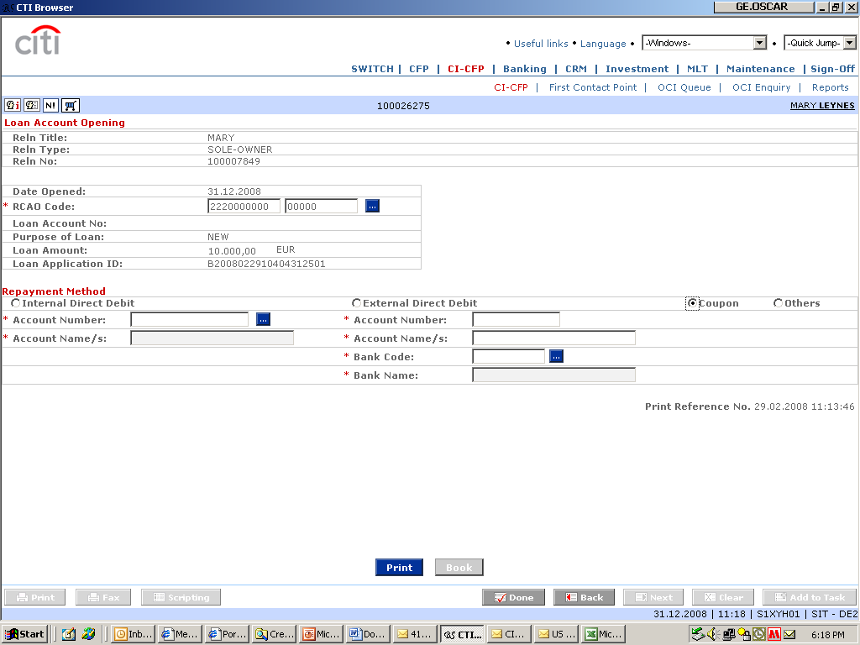
Product Trolley – Disbursal
Account Opening Screen:
1. Print Loan Contract
2. Book Loan Account
- Transaction Amount of 10.000 is moved from Loan Clearing GL(ZZZZZZZZZZ) to Processing Branch Loan GKV AAAAAAAAAA
- External Consolidation Amt 3500 is moved from Processing Branch Loan GKV AAAAAAAAAA to Account Domicile RC Loan Takeover GKV - BBBBBBBBBB

Slide 13
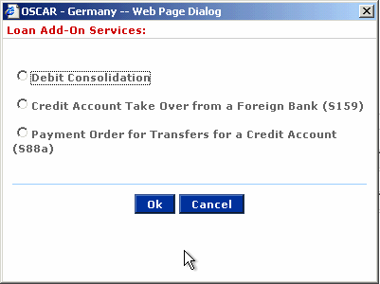
Product Trolley – Disbursal
Loan Account is booked:
Acct No: 00000340613775
00000340613775
Customer has the option to do external debt consolidation

Slide 14
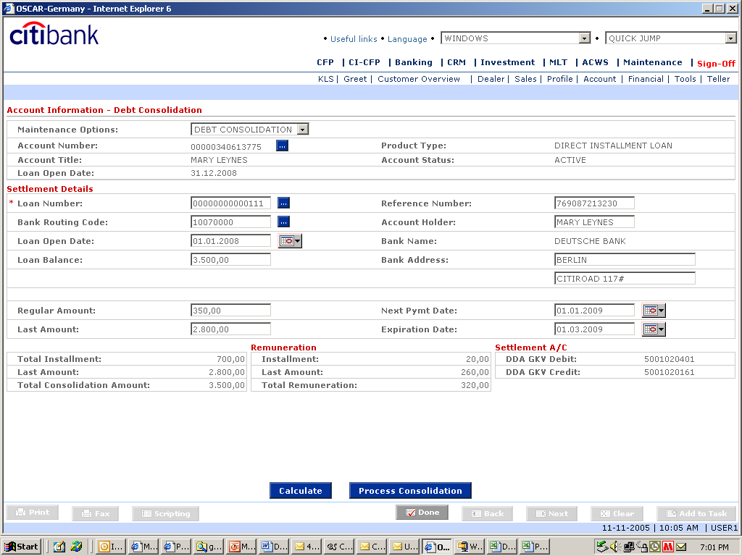
Product Trolley – Disbursal
Details for existing Deutsche Bank Loan
On Process Consolidation:
1. Standing instruction is setup to move external loan amount from Account Domicile RC Loan Takeover GKV BBBBBBBBBB to External bank
2. Refunding of interest
Click on Calculate to compute for total consolidation amount and total remuneration

Slide 15
Product Trolley – Debt Consolidation
BOOKED
PIL is now displayed as booked in the basket

Slide 16
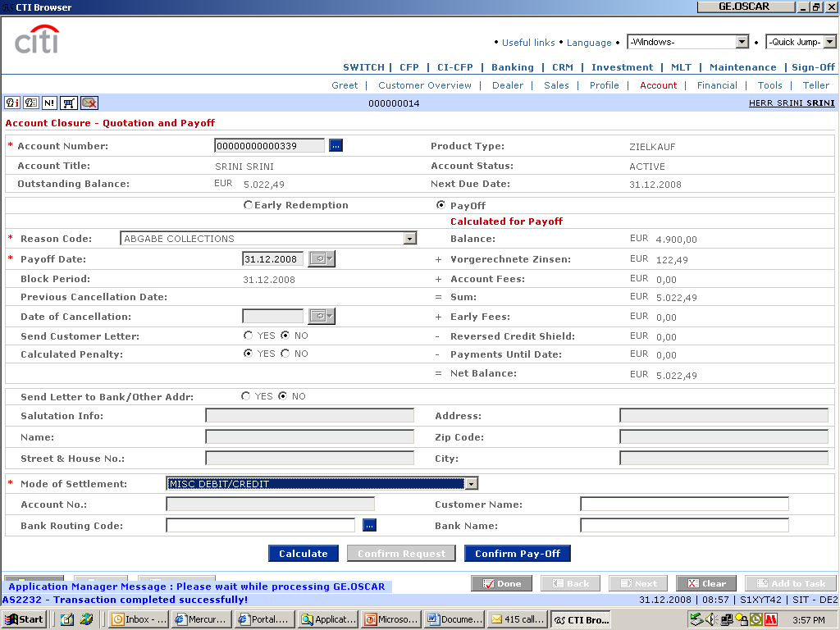
Product Trolley – Pay-off
To perform internal consolidation, Quotation and Pay-off function will be invoked --
Pay-off Existing Citibank Account 00000000000339 with balance of 1.500
DIRECT INSTALLMENT LOAN
MARY LEYNES
1.500, 00
1.350, 00
150, 00
0, 00
1.500, 00
0, 00
0, 00
0, 00
1.500, 00
Select Misc Debit/Credit as mode of Settlement.
1. Calculate Balance to be paid-off
2. On Confirm-Payoff, Misc Debit Screen is displayed

Slide 17
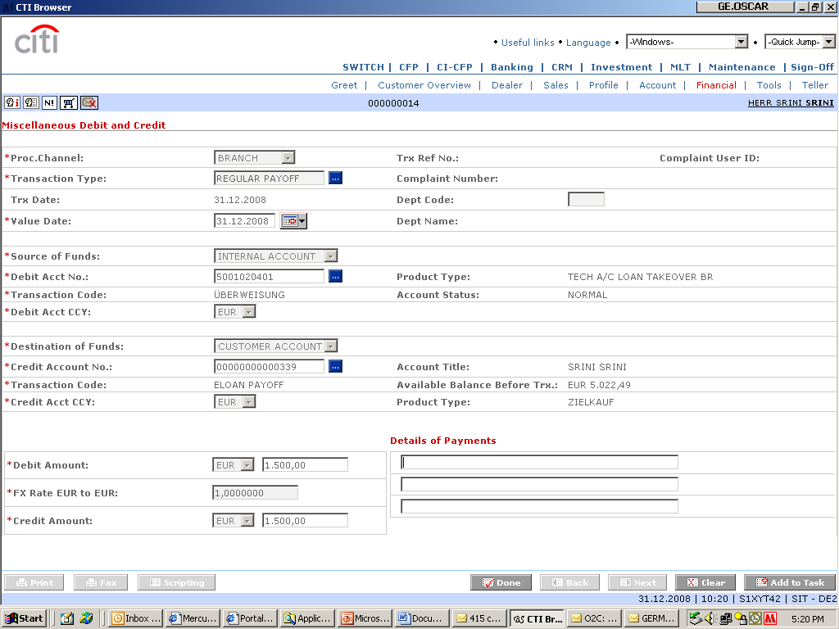
Product Trolley – Pay-off Settlement
Amount should be debited from Processing Branch Loan GKV:
Debit Loan GKV: AAAAAAAAAA
Credit Loan Account: 0000000000039
5001020401
MARY LEYNES
1.500, 00
DIRECT INSTALLMENT LOAN

Slide 18
Alternate Flow
Customer’s domicile branch is Dusseldorf. He opens a loan in Dusseldorf but external consolidation is not completed on the first visit.
Details as follows:
  Loan Amount: 10.000,00
  Disbursement Amount: 5.000,00
  External Debt Consolidation Amount: 3.500,00
  Internal Debt Consolidation Amount: 1.500,00

Slide 19
Loan is booked in customer’s domicile branch.
Cash
5.000
Dusseldorf
Loan GKV
AAAAAAAAAA
Pay-off Loan Account
00000000000339
Loan Clearing GL
Loan Clearing GL
Loan Clearing GL
Loan Clearing GL
Loan Clearing GL
1.500
10.000
3.500
Düsseldorf Loan TakeOver GKV
BBBBBBBBBB
Customer visits Duisburg branch to complete the external consolidation. There will be no discrepancies as the Account Domicile RC Loan Takeover GKV is being used.
Dusseldorf Loan TakeOver GKV
BBBBBBBBBB
External Loan Clearing
3.500

Slide 20
System Level Changes with this flow.
Internal consolidation amount should also be debited from Loan clearing GL and credited to loan GKV during loan booking. Currently internal consolidation amount is lying in the loan clearing GL.

